Slide 1
The Battle of Neighborhoods
A comparison of two popular cities in the state of Ohio, USA

Slide 2
Table of Contents
Introduction
Problem Statement
Methodology
Data Collection
Data Analysis
Approach
Visualization
Appendix

Slide 3
Introduction
Let’s take a look at the State, County and City information

Slide 4
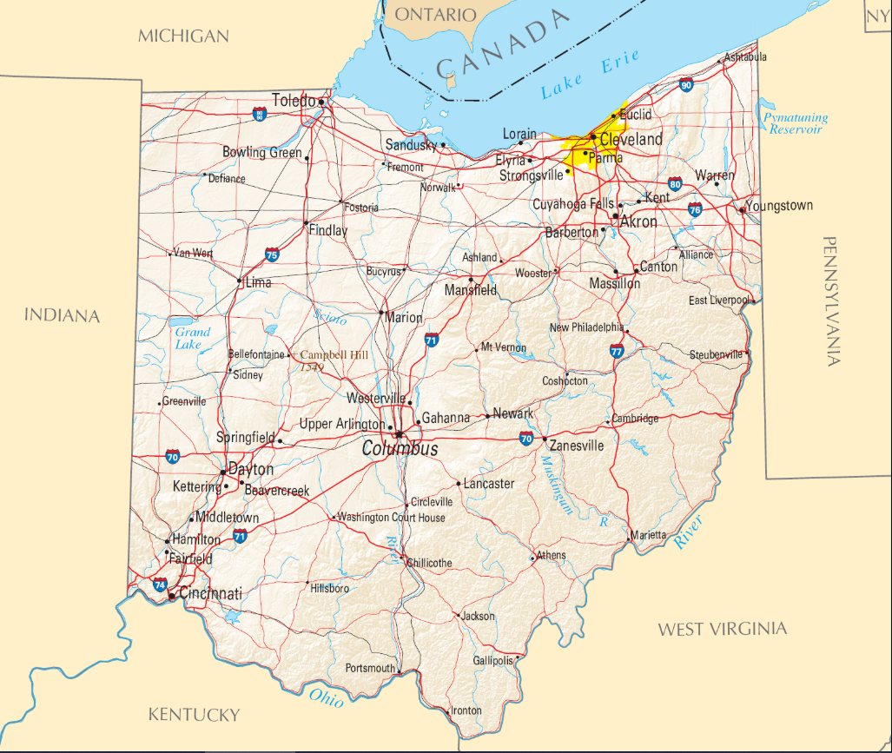
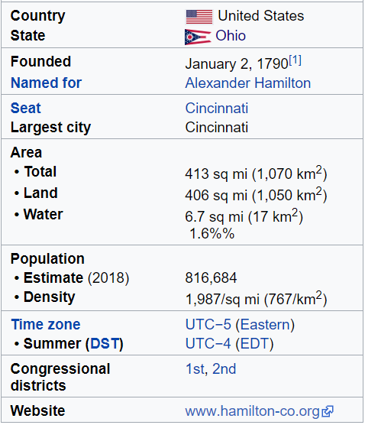
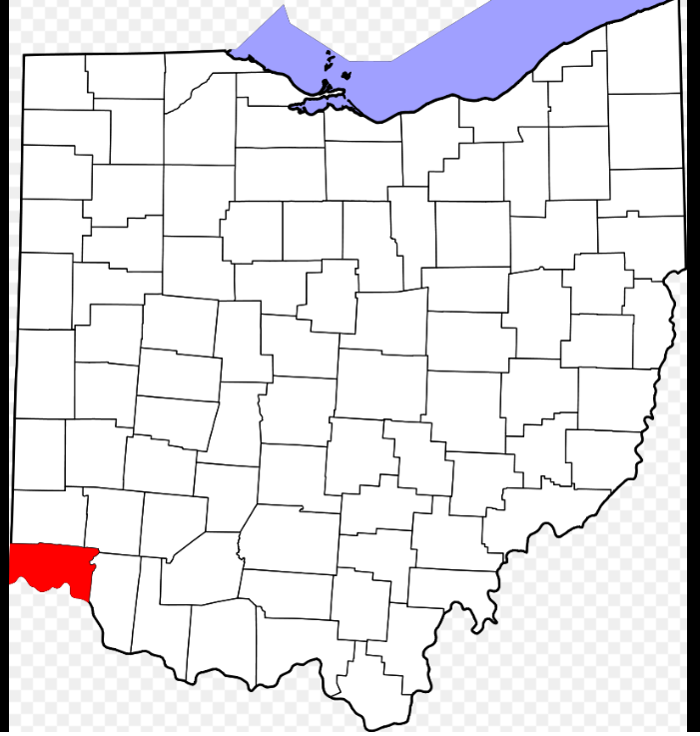
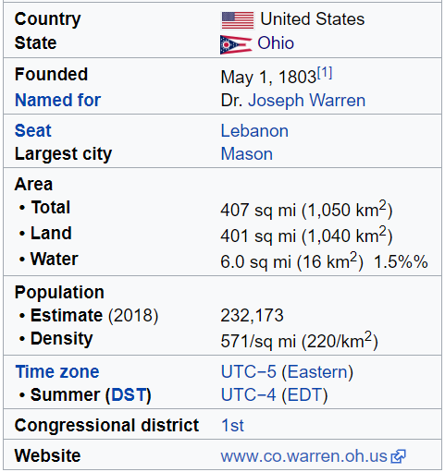
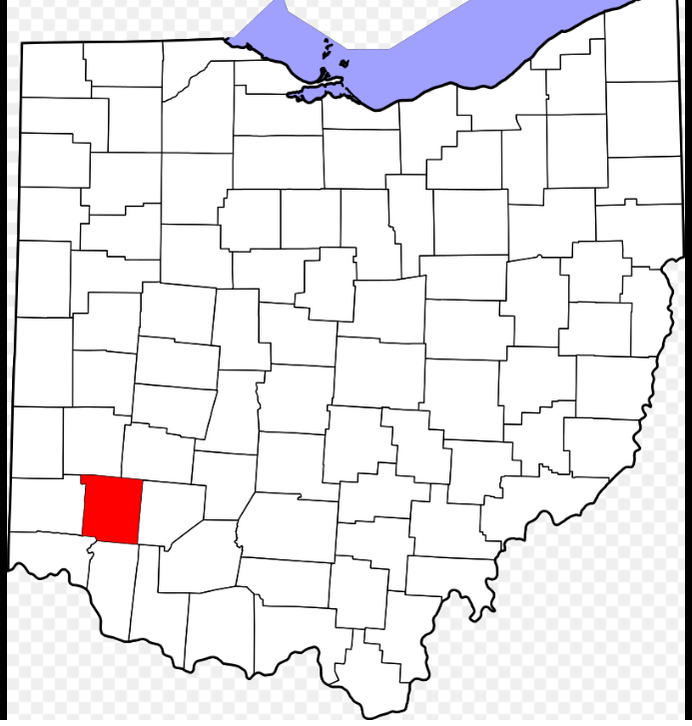
The State of Ohio & The two Counties
About Ohio
Ohio is a Midwestern state in the Great Lakes region of the United States. Of the fifty states, it is the 34th largest by area, the seventh most populous, and the tenth most densely populated. The state's capital and largest city is Columbus. Ohio is bordered by Pennsylvania to the east, Michigan to the northwest, Lake Erie to the north, Indiana to the west, Kentucky on the south, and West Virginia on the southeast.
Hamilton County is a county in the southwest corner of the U.S. state of Ohio. As of the 2010 census, the population was 802,374. making it the third-most populous county in Ohio. The county seat and largest city is Cincinnati. The county is named for the first Secretary of the Treasury, Alexander Hamilton.
Hamilton County is part of the Cincinnati-Middletown, OH-KY-IN Metropolitan Statistical Area.
Warren County is a county in the U.S. state of Ohio. As of the 2010 census, the population was 212,693. Its county seat is Lebanon. The county was created on May 1, 1803 from Hamilton County; it is named for Dr. Joseph Warren, a hero of the Revolution who sent Paul Revere and the overlooked William Dawes on their famous rides and who died at the Battle of Bunker Hill.
Warren County is part of the Cincinnati, OH-KY-IN Metropolitan Statistical Area.
Source: https://en.wikipedia.org

Slide 5
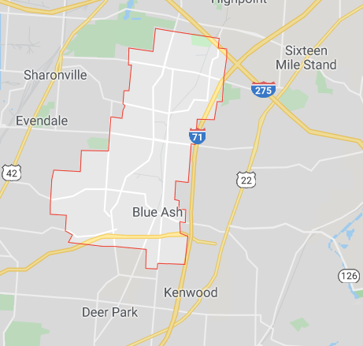
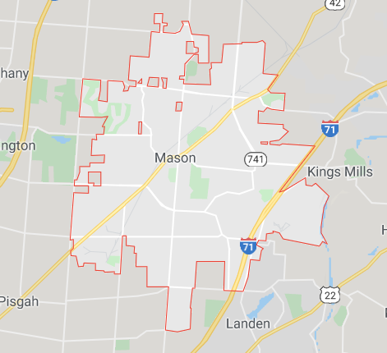
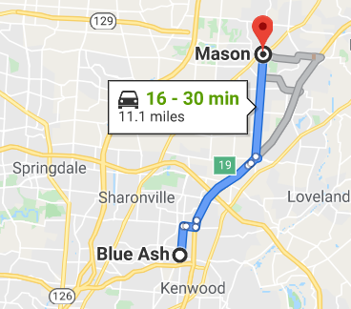
A Tale of two Cities – Blue Ash & Mason
Blue Ash is a city in Hamilton County, Ohio, United States, and is an inner suburb of Cincinnati, which is located to the south. Blue Ash is located at 39°14′50″N 84°22′34″W. Blue Ash can be reached by Interstate 71 to the east, Interstate 275 to the north, and Ronald Reagan Cross County Highway to the south.
Mason is a city in southwestern Warren County, Ohio, United States, approximately 22 miles (35 km) from downtown Cincinnati. Mason is located at 39°21′29″N 84°18′43″W. Mason is served by one interstate, I-71
 | CITY OF BLUE ASH | CITY OF MASON
Country | United States | United States
State | Ohio | Ohio
County | Hamilton | Warren
Government
• Mayor | Tom Adamec | Victor Kidd
Area
• Total | 7.59 sq mi (19.66 km²) | 18.67 sq mi (48.36 km2)
• Land | 7.58 sq mi (19.63 km²) | 18.63 sq mi (48.25 km2)
• Water | 0.01 sq mi (0.03 km²) | 0.04 sq mi (0.10 km2)
Elevation | 846 ft (258 m) | 810 ft (247 m)
Population (2010) | 12,114 | 30,712
• Density | 1,598.2/sq mi (617.1/km²) | 1,648.5/sq mi (636.5/km2)
Time zone | UTC-5 (Eastern (EST)) | UTC-5 (Eastern (EST))
• Summer (DST) | UTC-4 (EDT) | UTC-4 (EDT)
ZIP code | 45242 | 45040
Area code(s) | 513 | 513
Website | www.blueash.com | www.imaginemason.org
Map of Blue Ash
Map of Mason
Distance between the two cities
Source: https://en.wikipedia.org and https://www.google.com/maps

Slide 6
Problem Statement
Every problem has in it the seeds of its own solution - Norman Vincent Peale

Slide 7
The best choice to make
Background:
When a family moves from one location to another due to change of job or host of other reasons, they would be eager to find out more about the place they are moving to, including schools, rentals, property, commute, safety, restaurants etc.
Problem Statement:
Let’s help families that are moving to suburbs of Cincinnati, Ohio to make a choice between the two of the top ten suburbs - the city of Blue Ash Vs the city of Mason.
Summary:
Let’s analyze, visualize and evaluate the cities based on the following key parameters:
Education
Healthcare
Crime & Safety
Occupations
Properties and Rentals
Restaurants

Slide 8
Methodology
Data Requirements, Collection, Analysis and Approach

Slide 9
Data Requirements
Let’s see how data for each parameters listed on slide#7 will be sourced, analyzed and visualized to help make a decision
Education
Source | https://datausa.io https://www.greatschools.org
Data Summary & Analysis | The data comes from two different sources. Source #1 has details on college level education and Source #2 has details on schools within 3 miles of the city.
Approach | Use the data from above source websites to Capture concentrations for various degree programs and courses School rating for elementary, middle and high schools. 2. Use Foursquare API to plot the location on map 3. Use BeautifulSoup library to extract information from greatschools website
Visualization | Word cloud to display degree concentrations Histogram and bar charts for school ratings
Healthcare
Source | https://datausa.io
Data Summary & Analysis | Use Foursquare API to download list of all hospitals and other clinics information. Use datausa.io website to download clinicians to patient ratio information
Approach | From the above data source, assess Number of hospitals, primary and urgent care clinics Clinicians to patient ratio 3. Use Foursquare API to plot the location on map with venue category = 4bf58dd8d48988d196941735
Visualization | Use line plots to depict ratio data Use maps and charts to depict hospital and clinics data

Slide 10
Data Requirements (Contd.)
Crime & Safety
Source | https://www.neighborhoodscout.com
Data Summary & Analysis | Since data is not available on a downloadable format, use BeautifulSoup library to extract information from the website
Approach | Extract Crime Index, Annual Crime Rates and Safest neighborhoods information
Visualization | Use Folium map and heat maps to show safest neighborhoods
Properties and Rentals
Source | https://datausa.io https://www.apartments.com
Data Summary & Analysis | Use source #1 to understand the median property value and source #2 to find rentals in neighborhood
Approach | Data from source #1 is straight forward and can be utilized to visualize the property values in the city. For data from source #2, use BeautifulSoup library to extract information from the website
Visualization | Use bar charts and histogram to depict property values and folium maps for rentals
Occupations
Source | https://datausa.io
Data Summary & Analysis | Use Group, Subgroup and Occupation columns from data source
Approach | Since the data available is structured and straightforward, there is no need to apply any techniques to extract or cleanse data
Visualization | Word cloud and/or bar charts to display employment by different occupations
Restaurants
Source | Foursquare
Data Summary & Analysis | Since data is not available on a downloadable format, use Foursquare API to download restaurant information
Approach | Using maps, depict all restaurants and then group by different categories
Visualization | Use Bar and/or Pie charts for visualization

Slide 11
Appendix

Slide 12
Sample Data downloaded from different sources

